Slide 1
Data Warehouse Project

Slide 2

Teammates
Mohab El-Segini
01
02
AMr Ellakany
03
Shahd Mohamed
04
Doina Ahmed
05
Hafsa Zahran

Slide 3

Table of Contents
01
02
03
05
Business Processes &Bus Matrix
The Dimensional Modeling
Physical Data Model
04
SQL Queries
Indexing

Slide 4
01
The Business Processes And The Bus Matrix

Slide 5
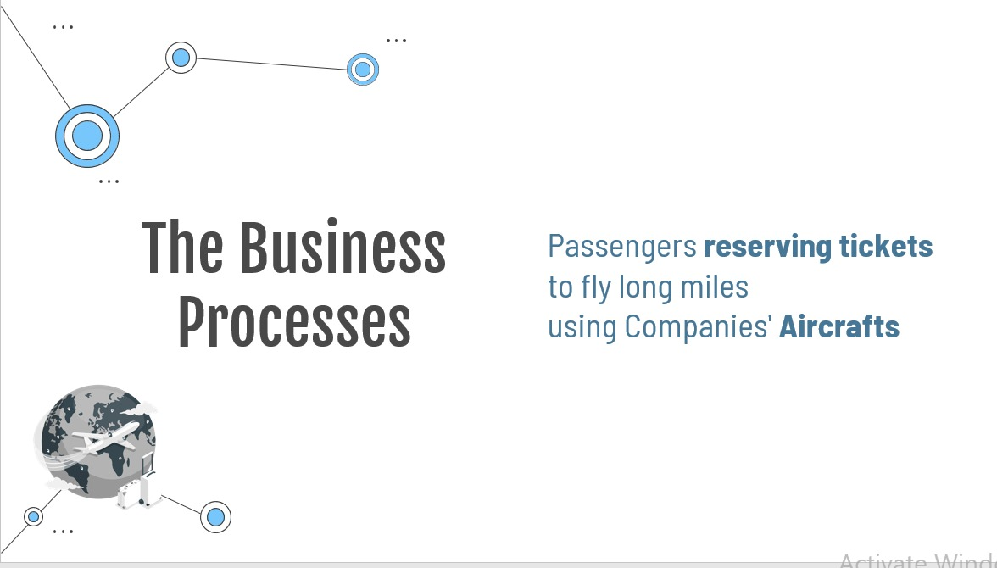

The Business Processes
Flights activity for Executives (Segments)
Marketing department (Leg & Passenger)
Finance department (Reservation)
Customer care (Customer interaction)

Slide 6
Bus Matrix
Bus matrix is a tabular view for the dimensions and facts to easily identify which dimensions are shared to create the fact table.

Slide 7
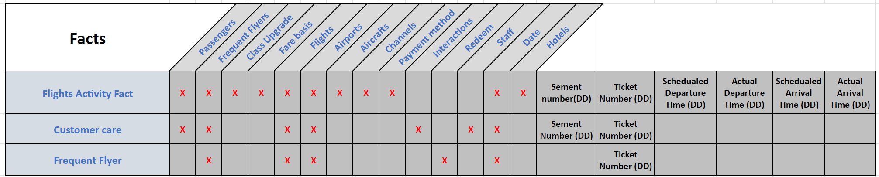
Bus Matrix

Slide 8
02
The Dimensional Modeling

Slide 9
Dimensional Modeling
A data structure technique optimized for data storage in a Data warehouse.

Slide 10
First Draft

Slide 11
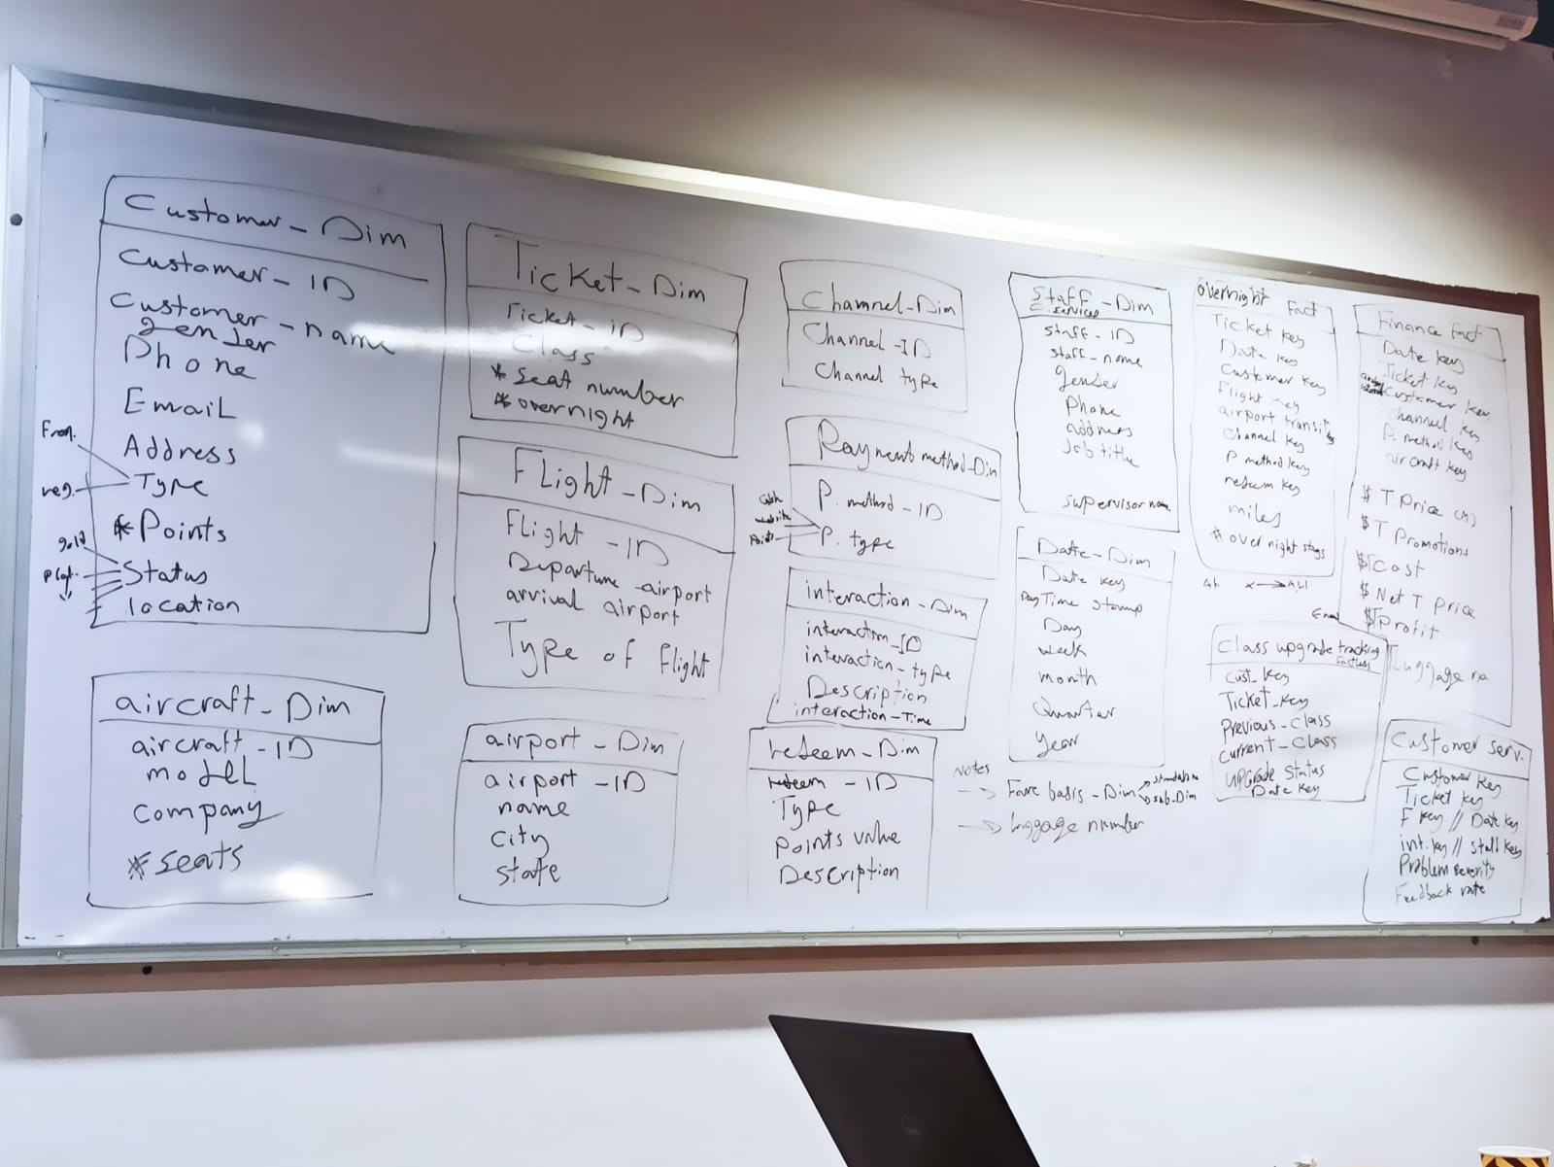

Slide 12
The Business Processes and their granularity
Flights activity for Executives
Marketing department
Finance department
Customer care

Slide 13

Passengers Dimension.
Flights Dimension.
Date Dimension.
Class Upgrade Dimension.
Channels Dimension.
Fare Basis Dimension.
Hotels Dimension.
Interactions Dimension.
Staff Dimension.
Airports Dimension
Aircrafts Dimension.
Payment methods Dimension.
Redeem Dimension.
Frequent Flyers Dimension

Slide 14
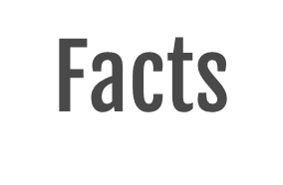
Flights Activity Fact.
Customer Care Fact.
Frequent Flyer Fact.

Slide 15
Requirements
Ensuring a good ongoing business (Flight Activity).
Analyzing which flight type frequent flyers take.
What Fare basis they pay?
How often they upgrade their ticket classes?
How they earn and redeem their earned miles?
Tracking the delay of each aircraft's departure in a level of time

Slide 16
Requirements
7. How long their overnight stay and in which hotel they stayed in?
8. The proportion of each membership status (Silver / Gold / Platinum).
9. Analyzing the company profits and which channel contributes more .
10. Analyzing the customers interactions, its handling and the problem severity of their complaints.
11. Analyzing Feedback rates.
12. Tracking which staff member handled the customer's interaction, The flight and seats of the passenger.

Slide 17
Final Logical Model

Slide 18
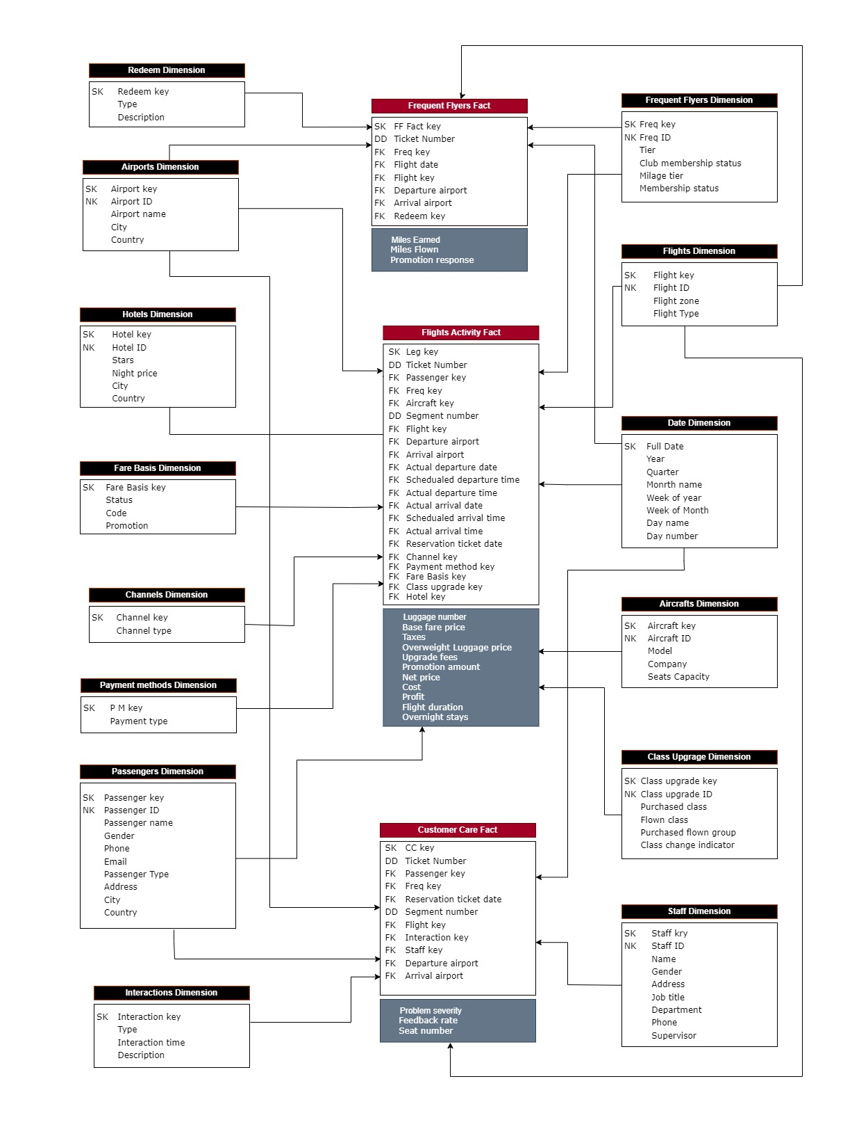

Slide 19
03
Physical Data Model

Slide 20



Physical Data Model Steps
Translate the logical data model to a physical data model
Create the table in oracle DBMS
Populate sample data and insert to be used in your queries

Slide 21
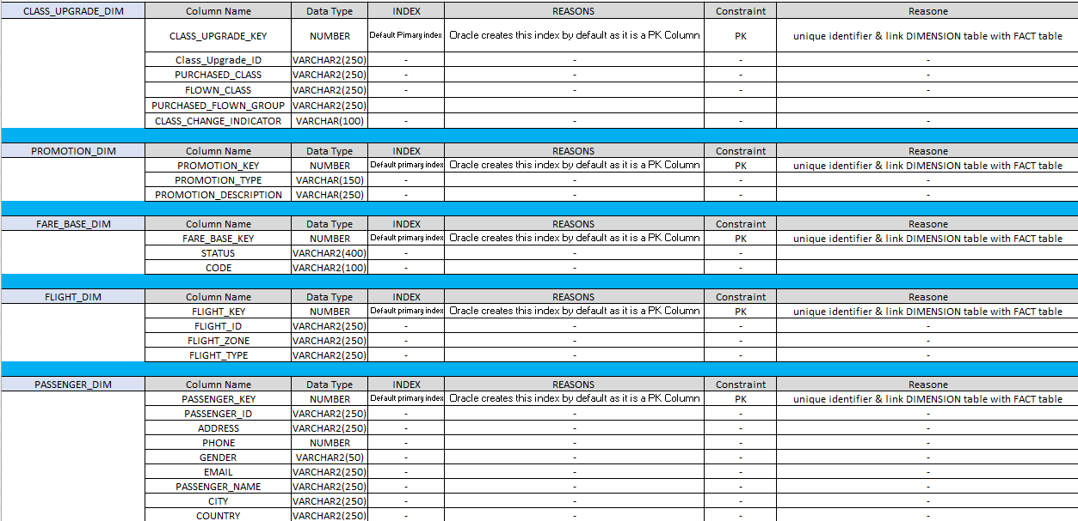
Translate logical model to physical model

Slide 22
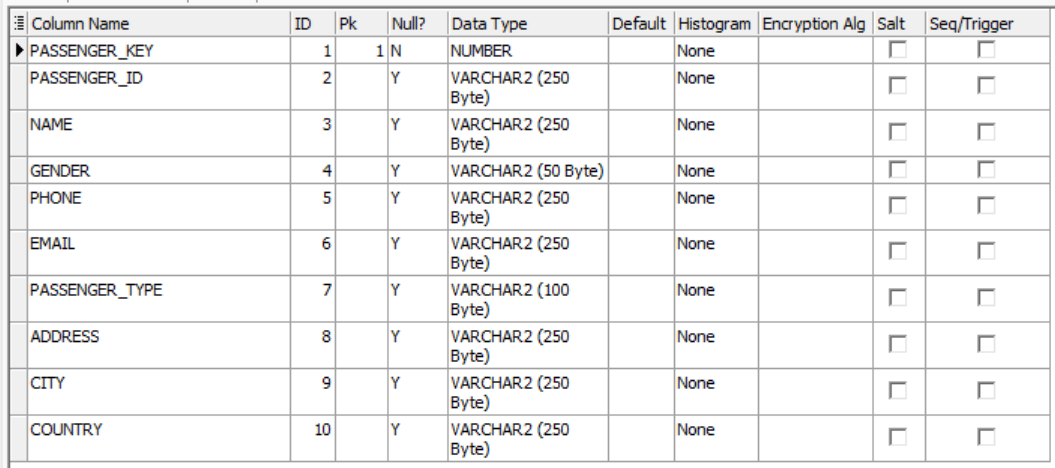
Create the table in oracle DBMS
1.Create Dimensions
Code | Output
---Create Passenger Dimension: CREATE TABLE Passengers_Dim ( Passenger_key NUMBER CONSTRAINT Passenger_pk_cons PRIMARY KEY, Passenger_ID VARCHAR2(250) CONSTRAINT Passenger_ID_unq UNIQUE, Name VARCHAR2(250), Gender VARCHAR2(50), Phone VARCHAR2(250), Email VARCHAR2(250), Passenger_Type VARCHAR2(100), Address VARCHAR2(250), City VARCHAR2(250), Country VARCHAR2(250) );

Slide 23
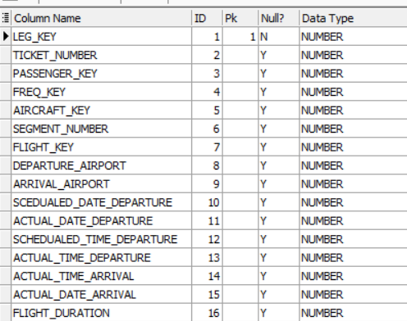
Create the table in oracle DBMS
2.Create Facts
Code | Output
CREATE TABLE flights_activity_Fact ( Leg_key NUMBER CONSTRAINT Leg_pk_cons PRIMARY KEY, Ticket_number NUMBER CONSTRAINT TN_unq_cons UNIQUE, Passenger_key NUMBER, Freq_key NUMBER, Aircraft_key NUMBER, Segment_number NUMBER , Flight_key NUMBER, Departure_airport NUMBER,

Slide 24
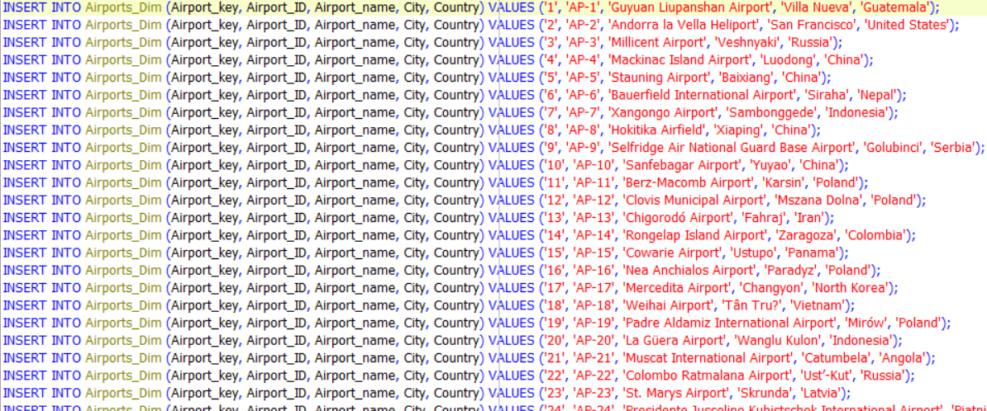
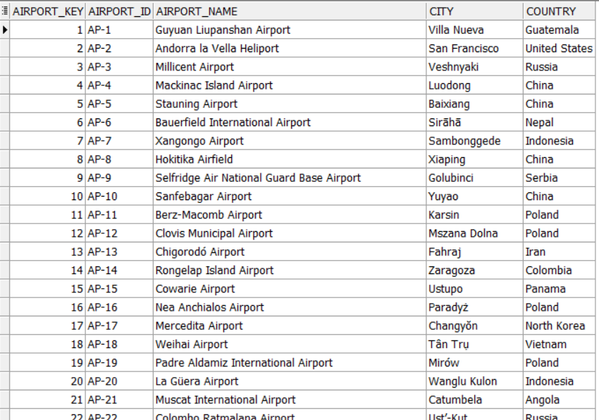
Insert Data in Dimensions
Code | Output

Slide 25
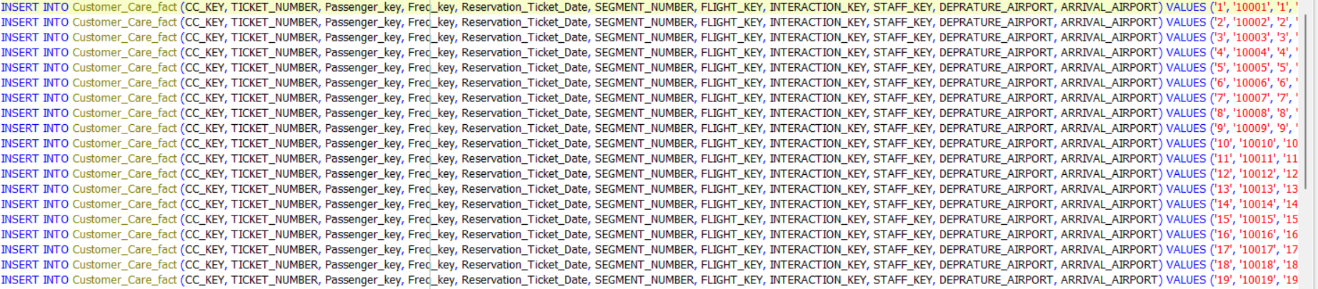
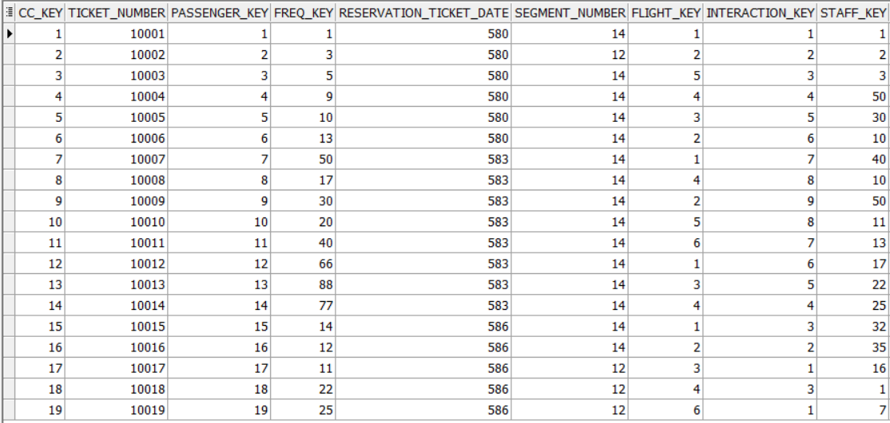
Insert Data in Facts
Code | Output

Slide 26
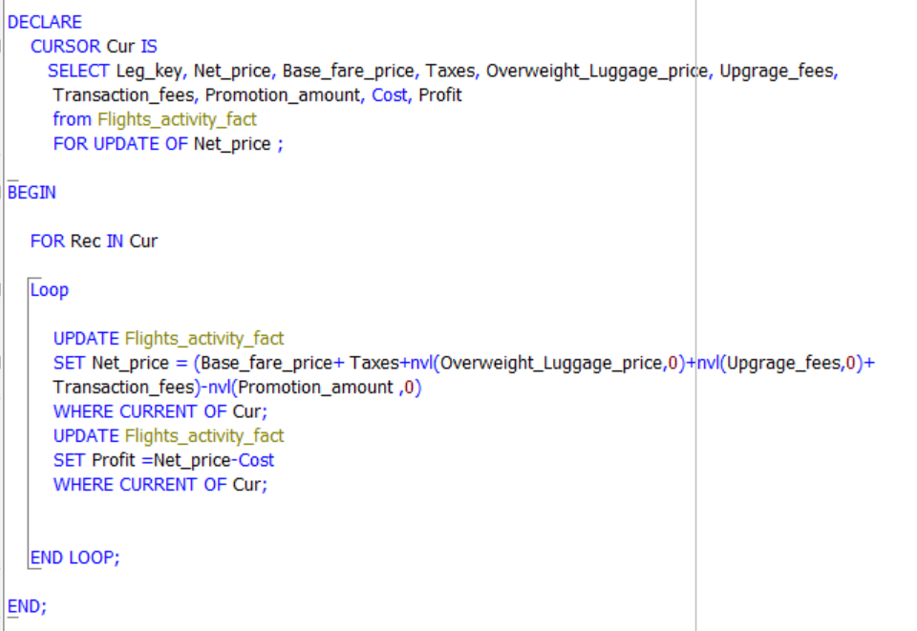
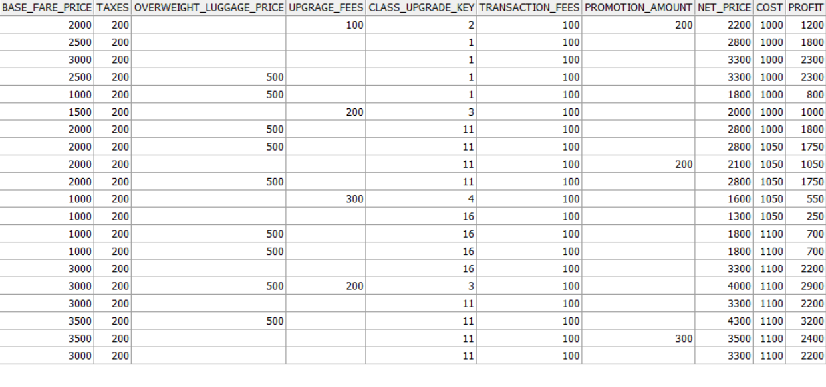
Insert Data in Facts Measures
Code | Output

Slide 27
04
SQL Queries

Slide 28
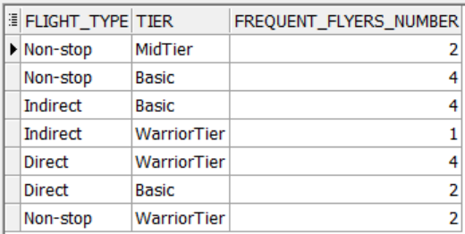
1- Which Flight types do frequent flyers take more depending on their tier?
SELECT fd.Flight_type, ff.Tier, COUNT(fa.Freq_key) AS Frequent_Flyers_number
FROM flights_activity_Fact fa
JOIN Flights_DIM fd
ON fa.Flight_key = fd.Flight_key
JOIN Frequent_flyers_Dim ff
ON ff.Freq_key = fa.Freq_key
GROUP BY fd.Flight_type, ff.Tier ;

Slide 29
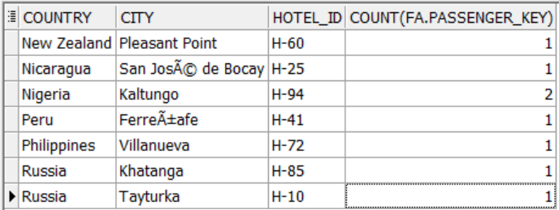
2- Where are the most used hotels for overnights?
SELECT hd.Country, hd.City, hd.Hotel_ID , count(fa.passenger_key)
FROM Hotels_DIM hd
JOIN flights_activity_Fact fa
ON hd.Hotel_key = fa.Hotel_key
GROUP BY hd.Country, hd.City, hd.Hotel_ID
ORDER BY hd.Country ;

Slide 30
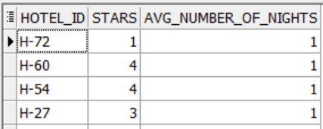
3- What is the average number of nights passengers stay in each hotel?
SELECT h.Hotel_ID, h.Stars, TRUNC(AVG(fa.overnight_stays),0) AVG_number_of_nights
FROM Hotels_DIM h
JOIN flights_activity_Fact fa
ON fa.Hotel_key = h.Hotel_key
GROUP BY h.Hotel_ID, h.Stars
ORDER BY AVG_number_of_nights DESC;

Slide 31
4- What are the numbers of Feedbacks Ratings based on their degree of rate per year?
SELECT d.Year, i.TYPE, f.Feedback_Rate,
COUNT(f.Feedback_Rate) AS "No. of Feedback Ratings", i.Description
FROM Interactions_DIM i
JOIN Customer_Care_fact f
ON i.Interaction_key = f.Interaction_key
JOIN Date_Dim d
ON d.Full_date = f.Reservation_Ticket_Date
WHERE i.TYPE = 'Feedback'
GROUP BY d.Year, i.TYPE, f.Feedback_Rate, i.Description
ORDER BY COUNT(f.Feedback_Rate) DESC ;

Slide 32
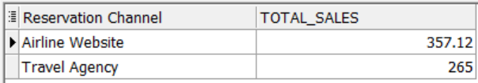
4- Which Reservation Channel contributes more to the sales of the company?
SELECT ch.Channel_Type AS "Reservation Channel", SUM(fa.Net_price) AS Total_sales
FROM flights_activity_Fact fa
JOIN Channels_Dim ch
ON fa.Channel_key = ch.channel_key
GROUP BY ch.Channel_Type
ORDER BY Total_sales DESC;

Slide 33
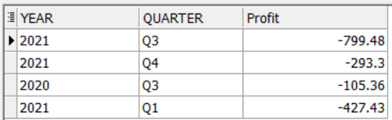
5- What are the profits of the company per Quarter?
SELECT d.Year, d.Quarter, SUM(fa.Profit) AS "Profit"
FROM flights_activity_Fact fa
JOIN Date_Dim d
ON fa.Reservation_Ticket_Date = d.full_date
GROUP BY d.Year, d.Quarter ;

Slide 34
05
Indexing

Slide 35
why do we need index in data warehouse

Slide 36
Characteristics of indexed column
Distribution
Cardinality
Value range

Slide 37
Indexing Techniques

Slide 38
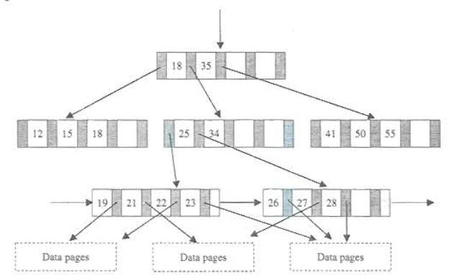
B+-Tree indexes
The most used data structures to improve query processing time in operational databases.

Slide 39
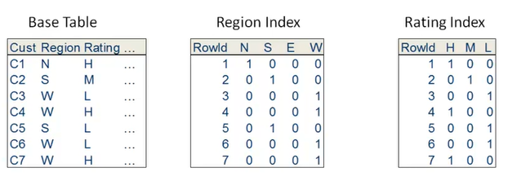
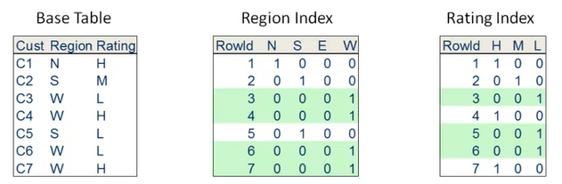
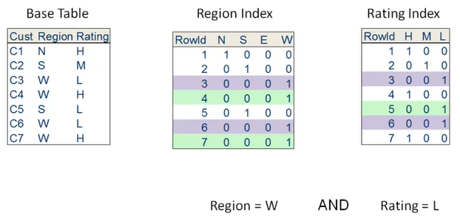
Bitmap Index
SELECT Customers FROM Base Table WHERE Region = W AND Rating = L
The bitmap representation is an alternate method of the row ids representation.

Slide 40
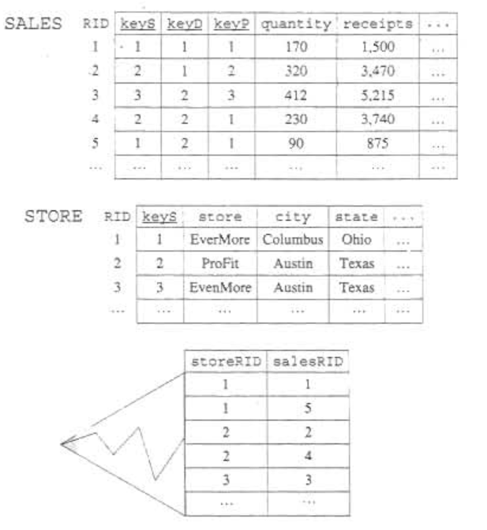
Join Indexes
The join index is created by joining R and S and projecting the result on R and S primary keys.

Slide 41
Thanks!

